Slide 1
POCO C++ Library 2
조욱래
2012-12-21

Slide 2
NotiFiations & Events

Slide 3
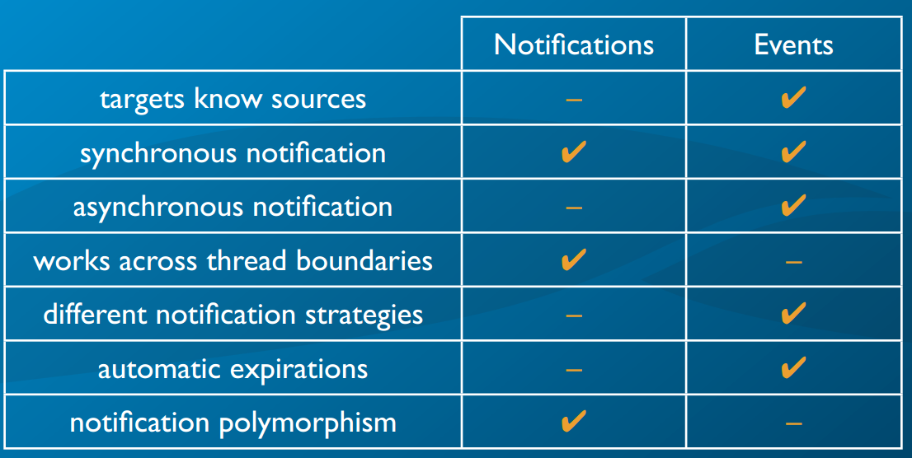

Slide 4
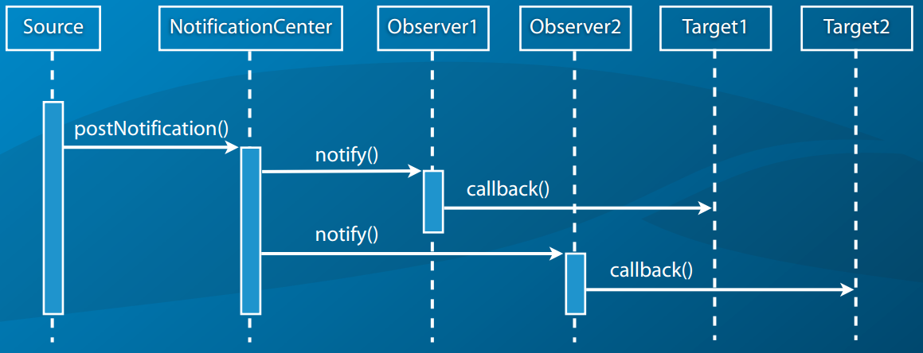
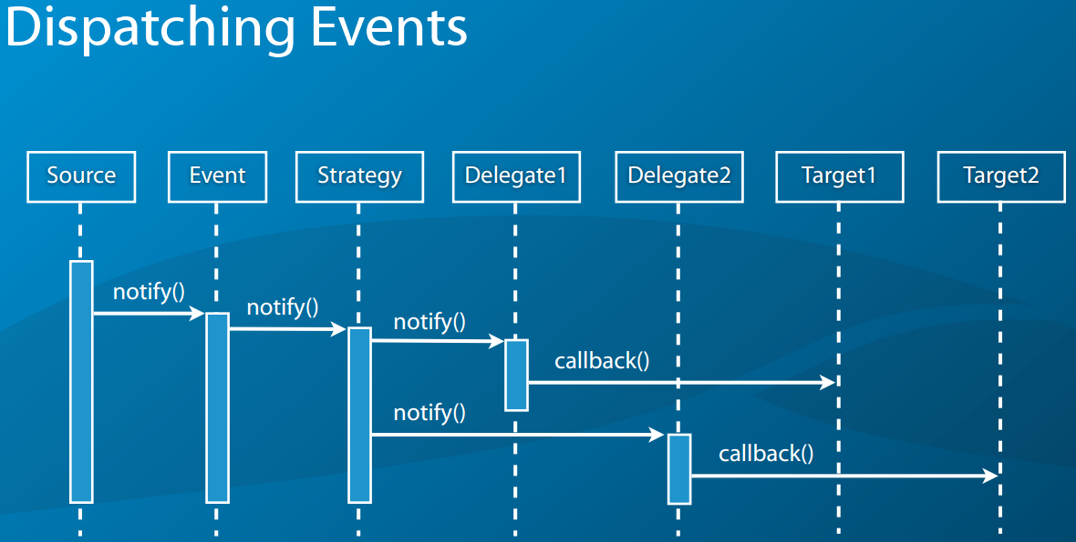
Dispatching Notifications

Slide 5
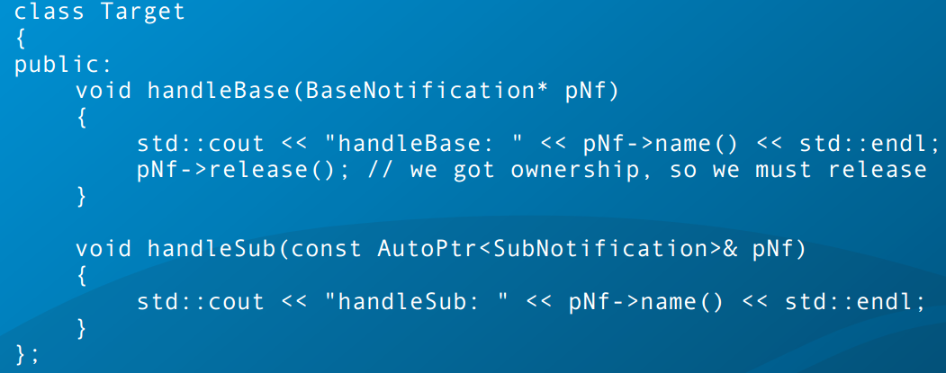
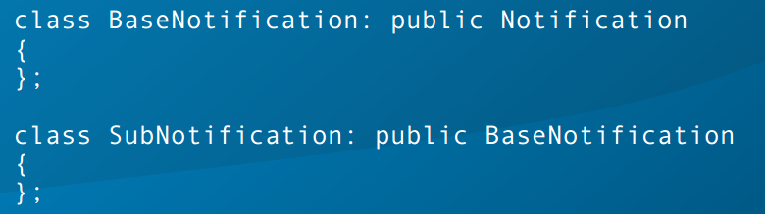
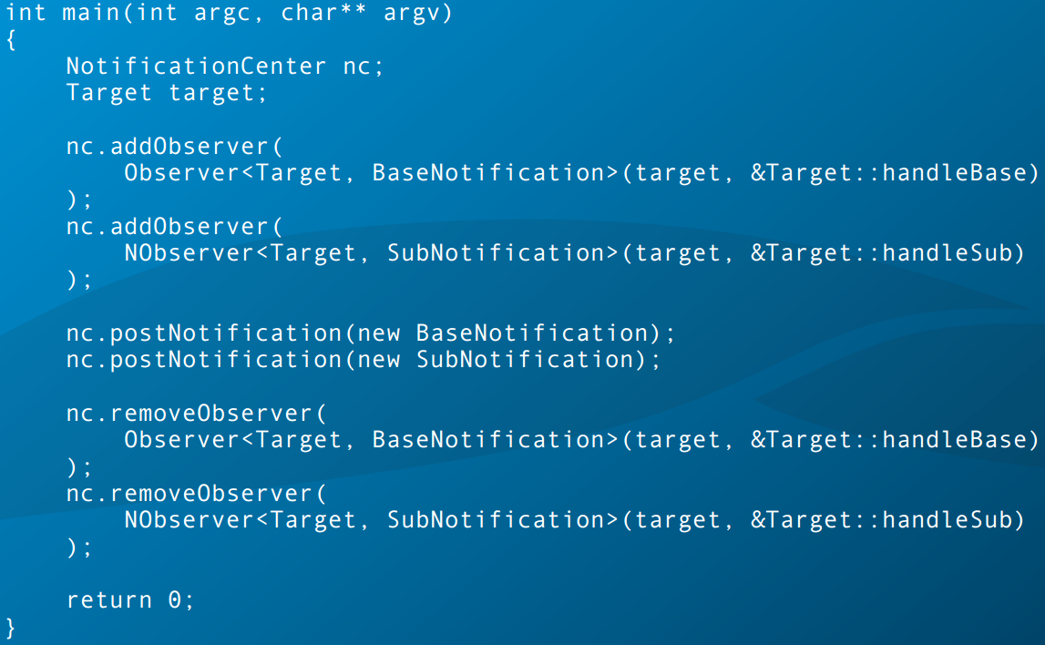

Slide 6
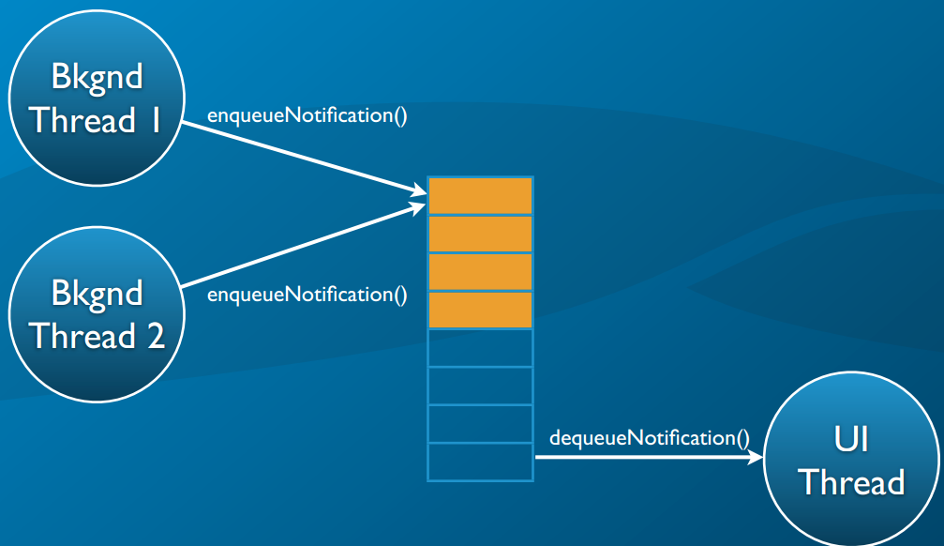
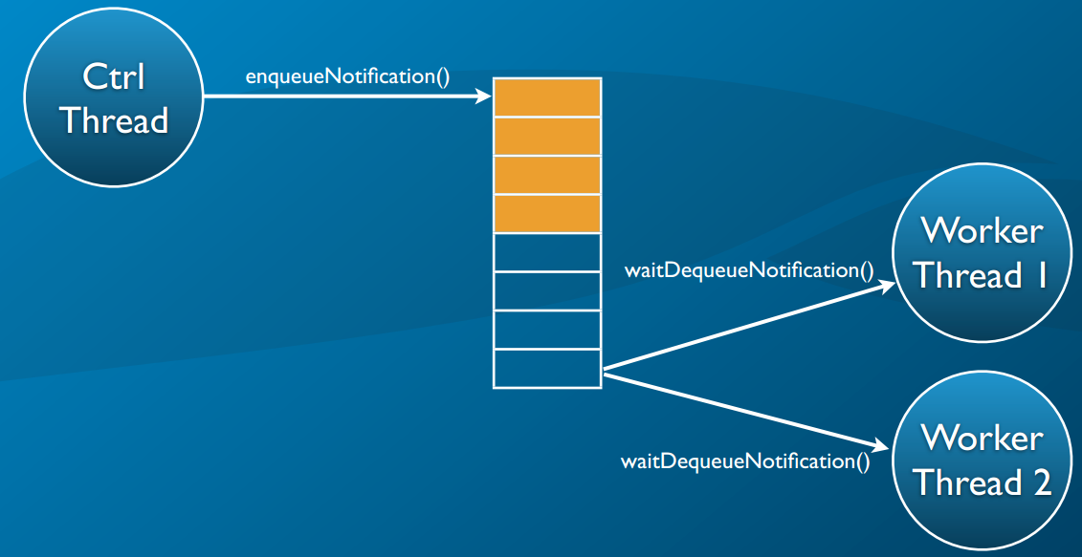

Slide 7

Enqueueing & Dequeueing

Slide 8
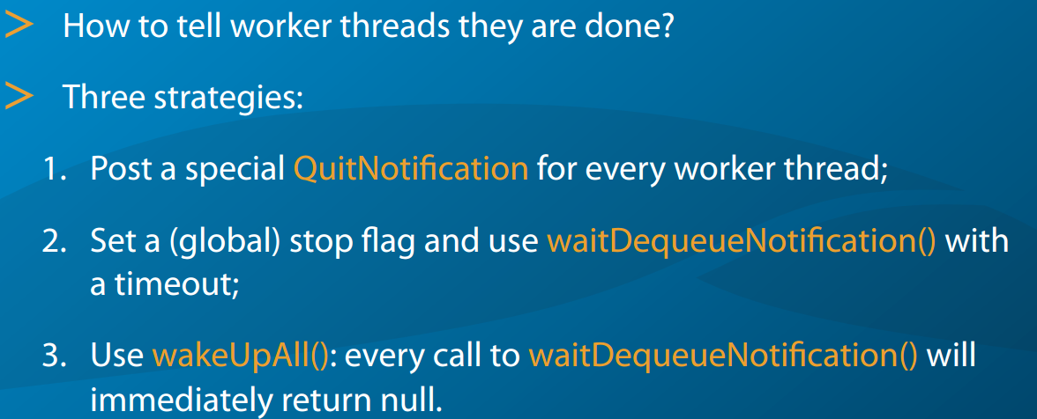
Shutting Down a Queue

Slide 9
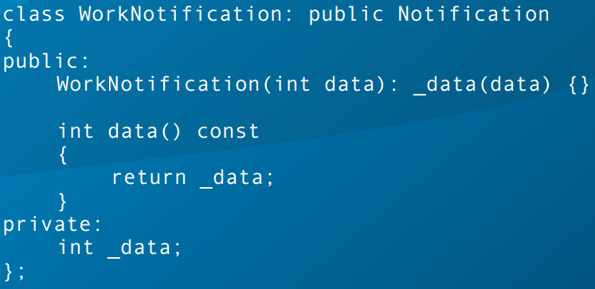
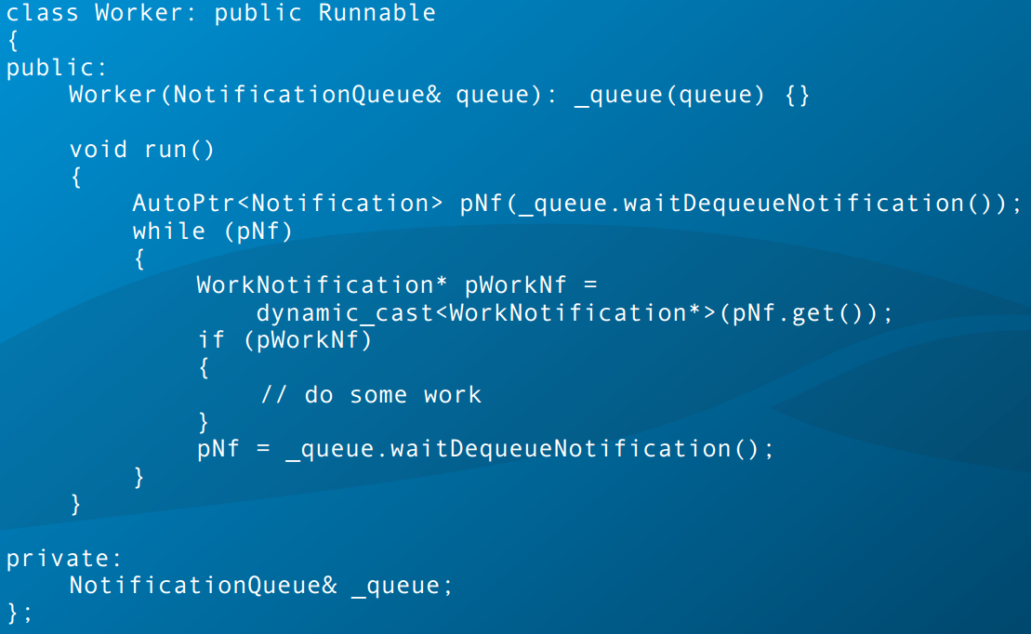
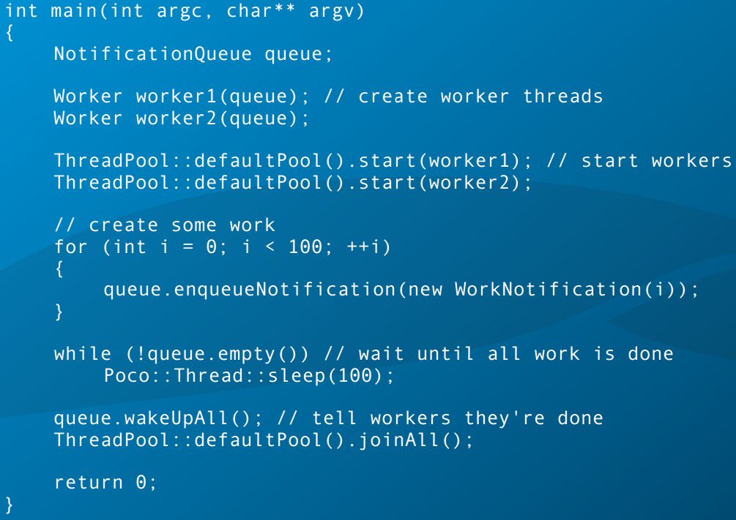
Shutting Down a Queue: wakeUpAll()

Slide 10
Special Queues
PriorityNotiﬁcationQueue
notiﬁcations are tagged with a priority and dequeued in order of their priority (lower numerical value means higher priority)
TimedNotiﬁcationQueue
notifications are tagged with a timestamp and dequeued in order of their timestamps

Slide 11
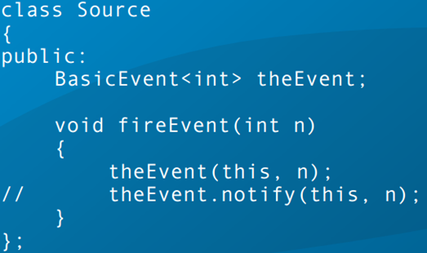
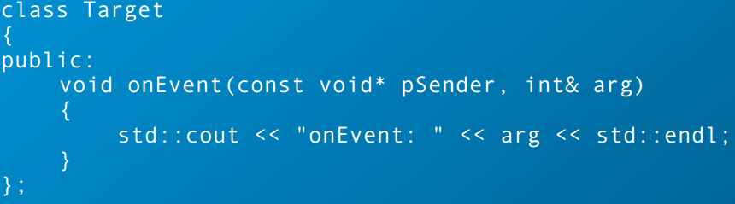
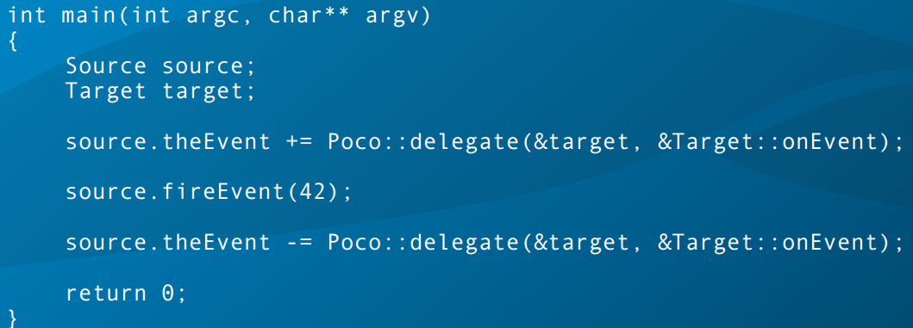
Events

Slide 12
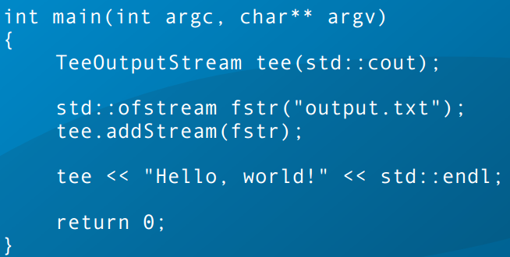
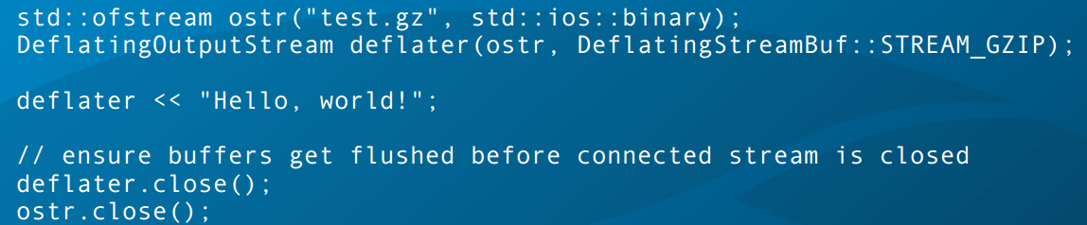
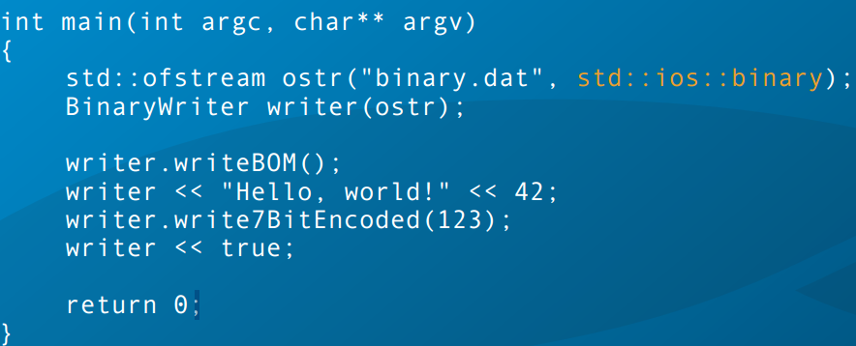
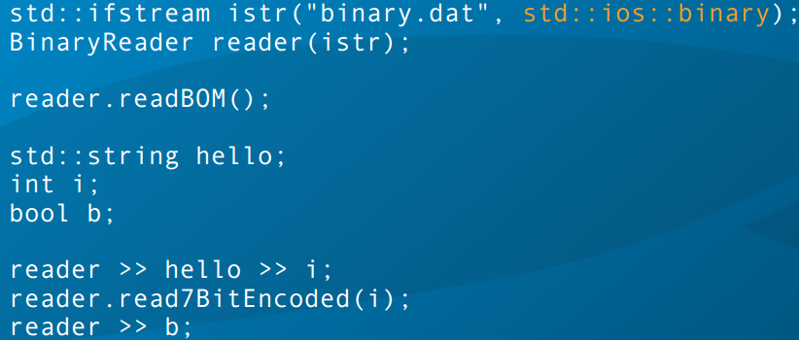
Stream

Slide 13
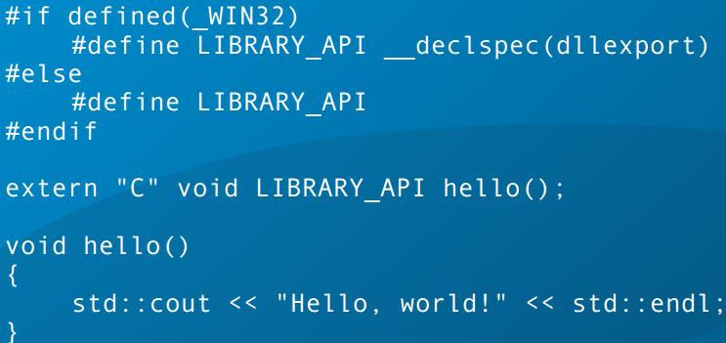
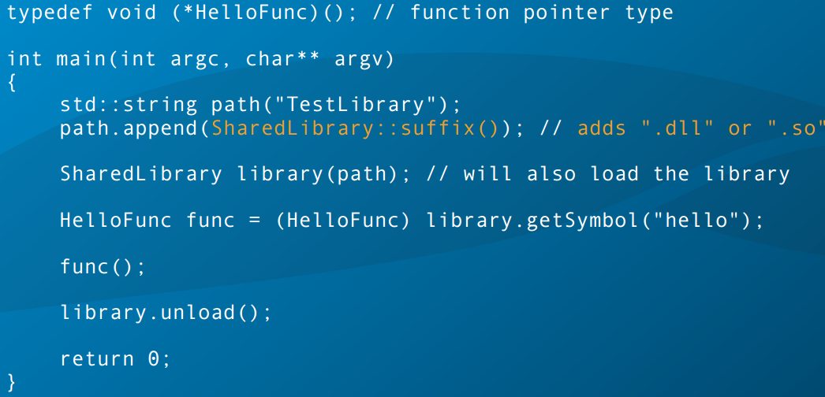
Shared Libraries

Slide 14
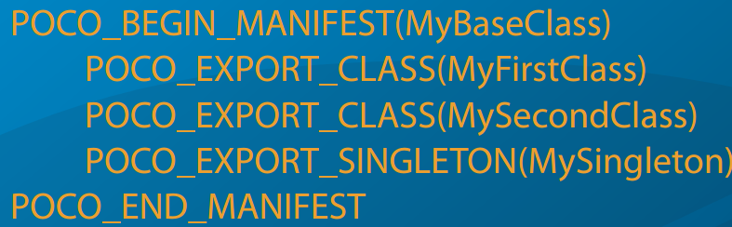
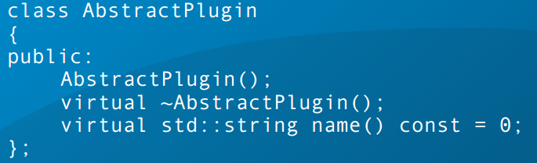
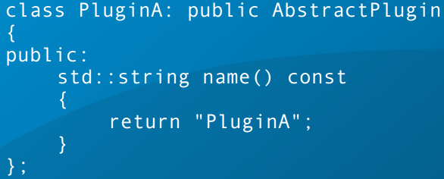
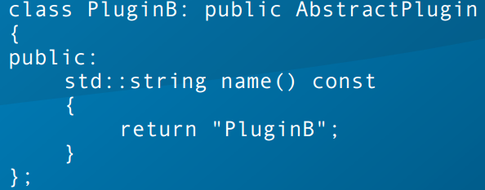
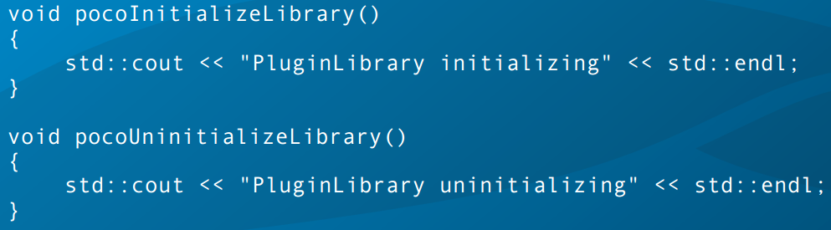
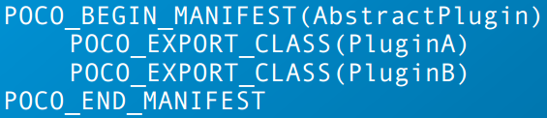
Writing a Class Library

Slide 15
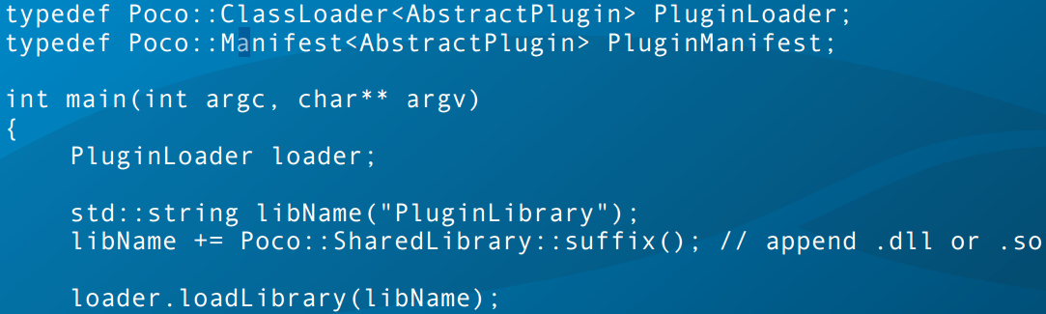
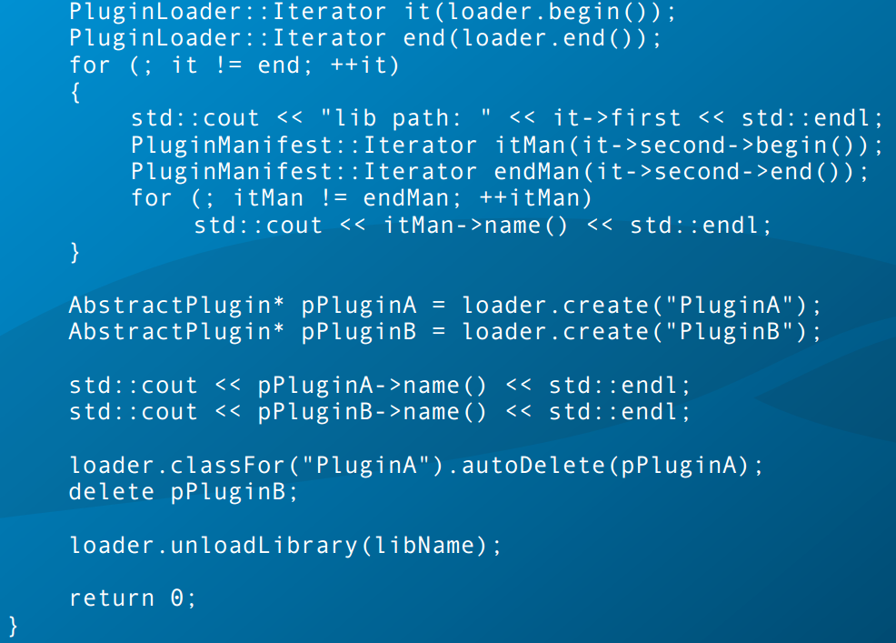
main.cpp

Slide 16
Multithreading
Thread Class
an optional name
a priority (Thread::Priority)
a unique ID (integer)
Poco::Runnable
provides an entry point for a thread. : run()
Poco::RunnableAdapter
start() join() setPriority() id() name() isRunning() current() yield() sleep(milliseconds)

Slide 17
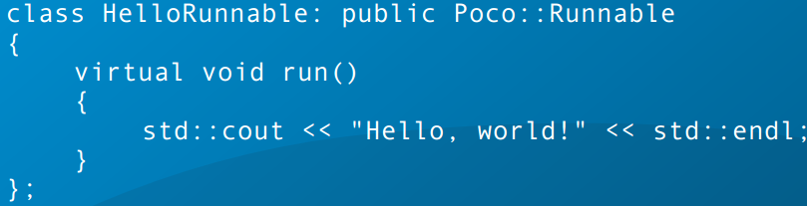
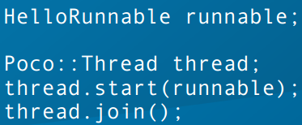
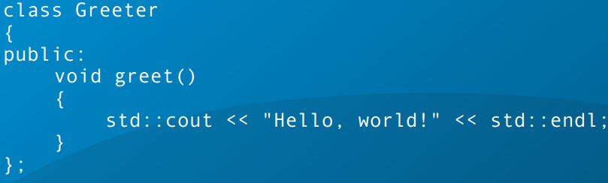
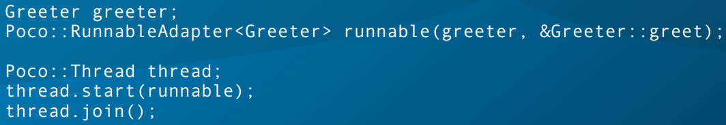
Thread 예

Slide 18
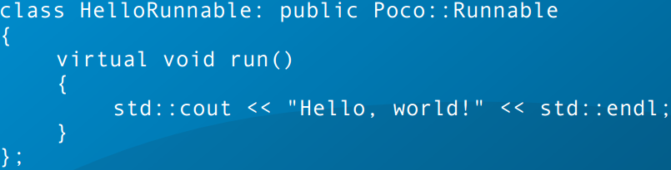
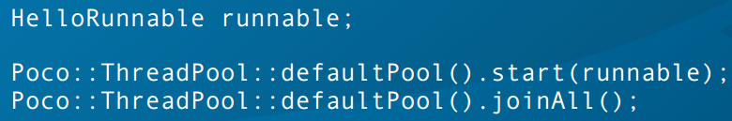
Thread Pools
Managing the lifetime of Thread
start() or startWithPriority()
NoThreadAvailableException
addCapacity(int n)
default ThreadPool instance with an initial capacity of 16 threads.
joinAll()
collect()

Slide 19
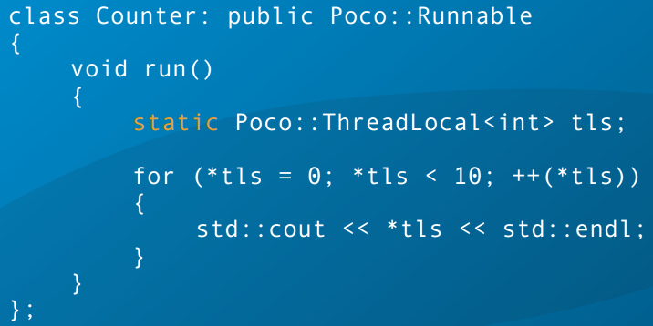
Thread Local Storage

Slide 20
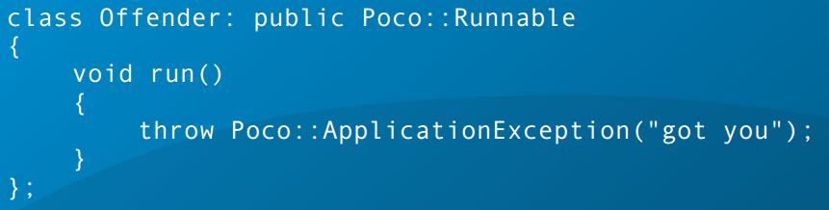
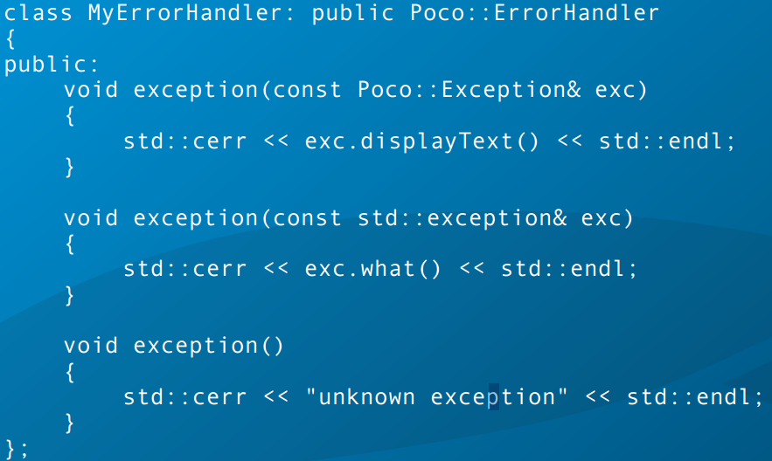
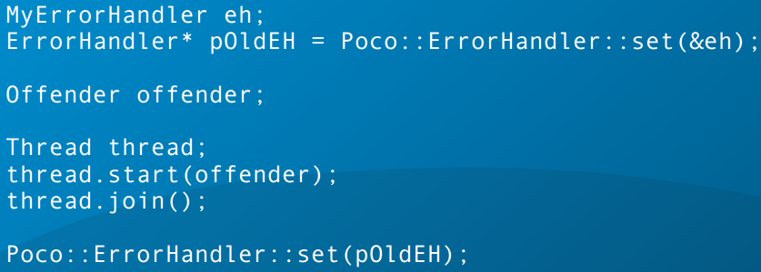
The ErrorHandler Class
global error handler
That gets notified about unhandled exceptions in threads.

Slide 21
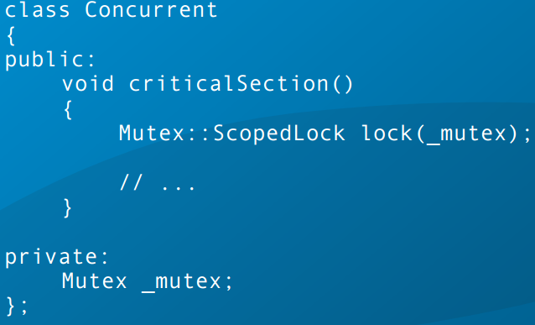
Thread Synchronization
Mutex
Poco::Mutex is a recursive;
Poco::FastMutex is a non-recursive mutex
On Windows, it is actually recursive.
lock() lock(long millisecs) unlock() tryLock()
Scoped Lock
Mutex::ScopedLock & FastMutex::ScopedLock.

Slide 22
Events
set() wait() wait(long milliseconds) reset()
tryWait(long milliseconds)
If the Event is signalled within the given interval, returns true.

Slide 23
Reader Writer Locks
allows multiple concurrent readers, xor one exclusive writer.
void readLock() bool tryReadLock()
void writeLock() ,bool tryWriteLock()
void unlock()

Slide 24
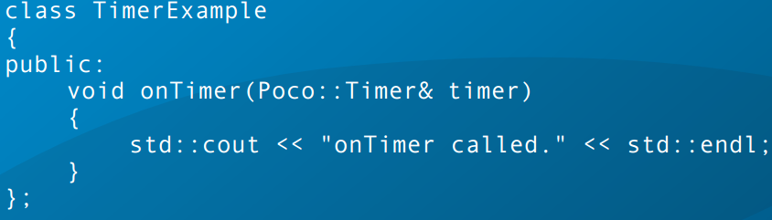
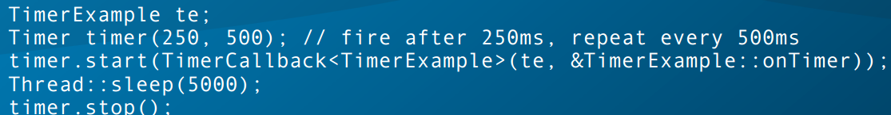
Timer

Slide 25
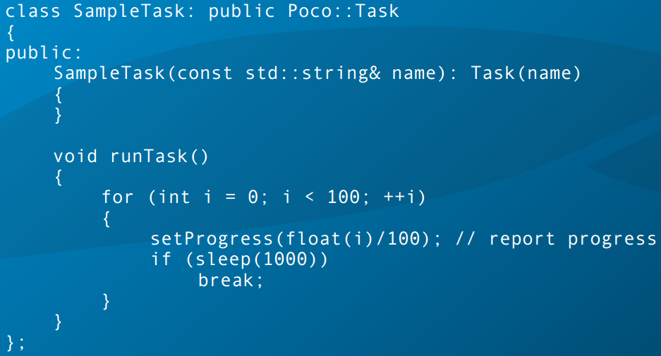
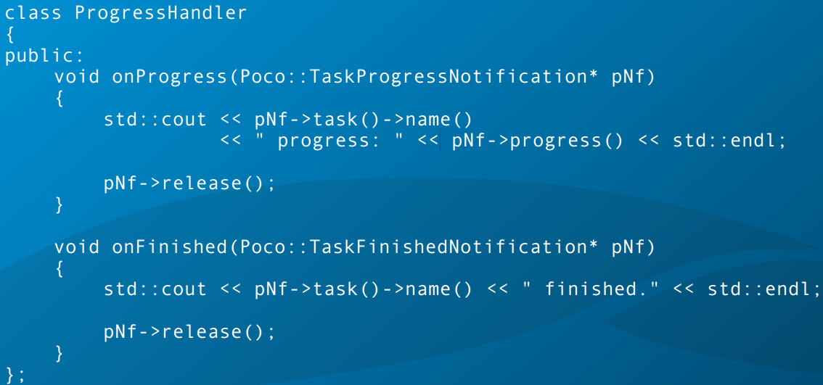
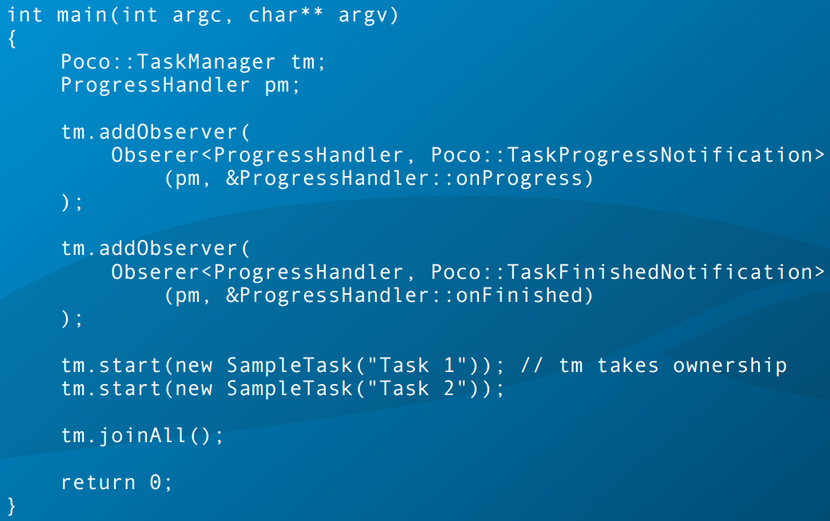
Task Management

Slide 26
Active Objects

Slide 27
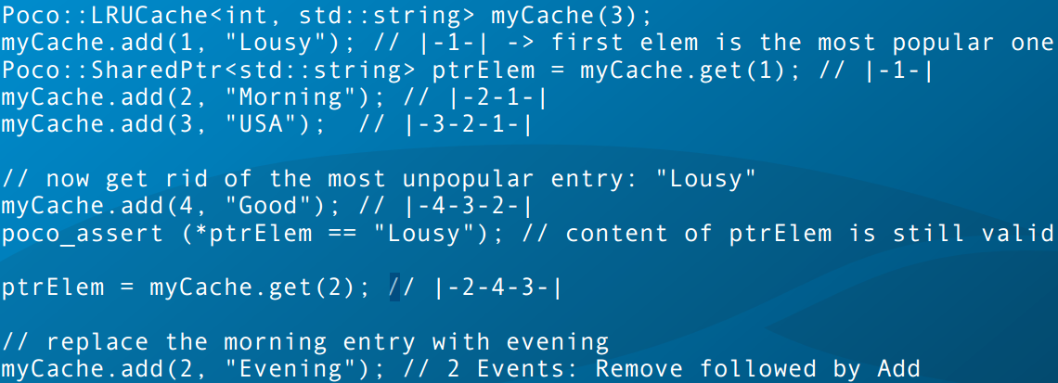
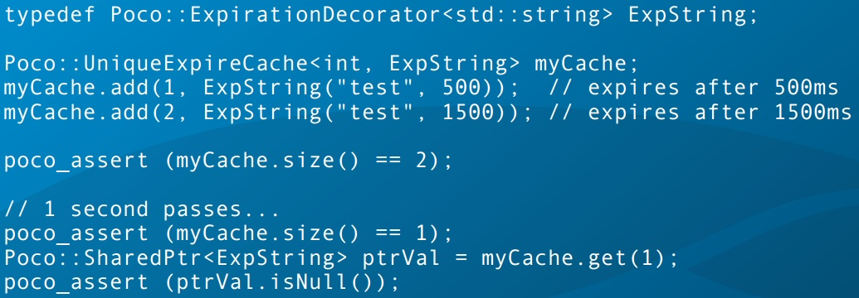
The Cache Framework

Slide 28
Expiration based on last access time
AccessExpireCache:
elements in the cache expire if they are not accessed within a given cache speciﬁc time interval
UniqueAccessExpireCache:
the time interval can be deﬁned for each individual element of the cache

Slide 29
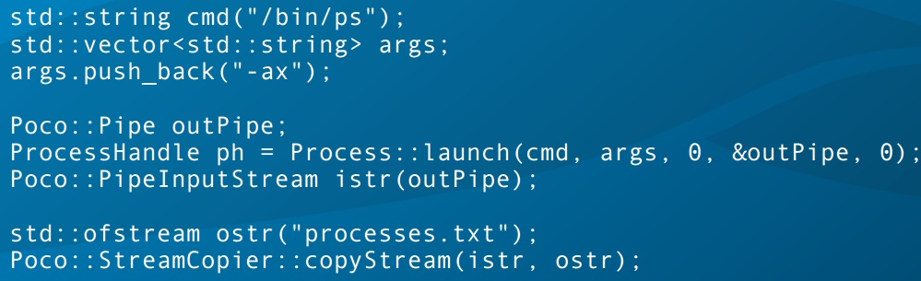
Creating a Process With I/O Redirection

Slide 30
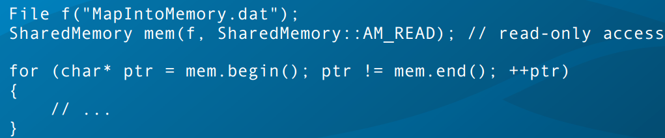
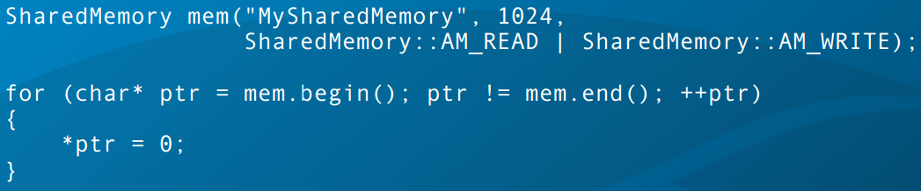
SharedMemory

Slide 31



URI Examples

Slide 32

UUIDGenerator

Slide 33
Q&A

